Slide 1
Synchronization Examples Lesson 4 Java Synchronization & Others
David Liu
Fall 2021

Slide 2
Java Synchronization
Java provides rich set of synchronization features:
Java monitors
Reentrant locks
Semaphores
Condition variables

Slide 3
Java Monitors
Every Java object has associated with it a single lock.
If a method is declared as synchronized, a calling thread must own the lock for the object.
If the lock is owned by another thread, the calling thread must wait for the lock until it is released.
Locks are released when the owning thread exits the synchronized method.

Slide 4
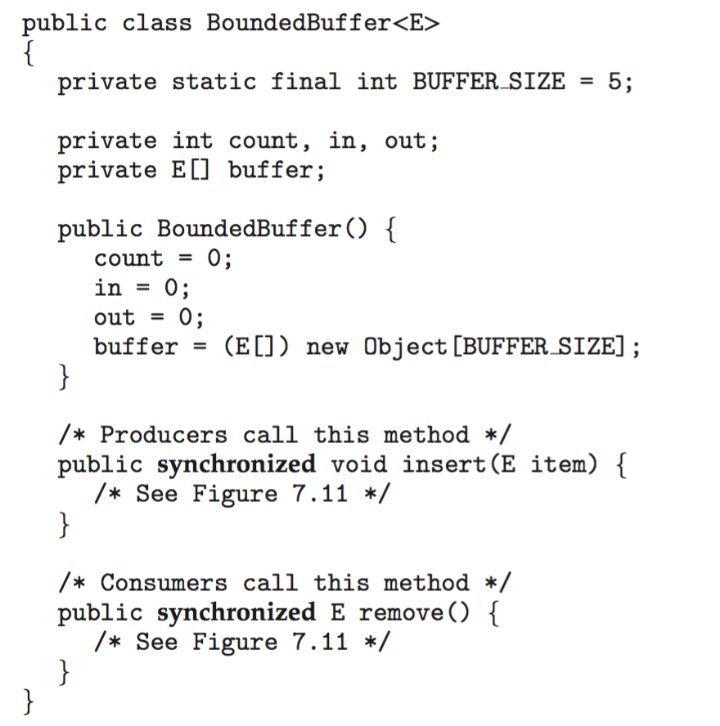
Bounded Buffer – Java Object Lock

Slide 5
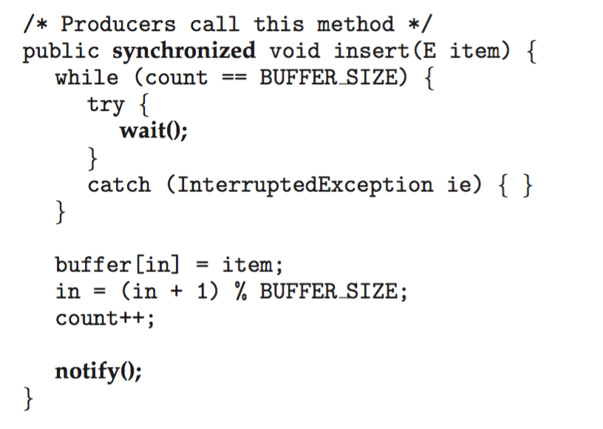
Bounded Buffer – Java Object Lock
Move a producer or consumer from wait set to the entry set

Slide 6
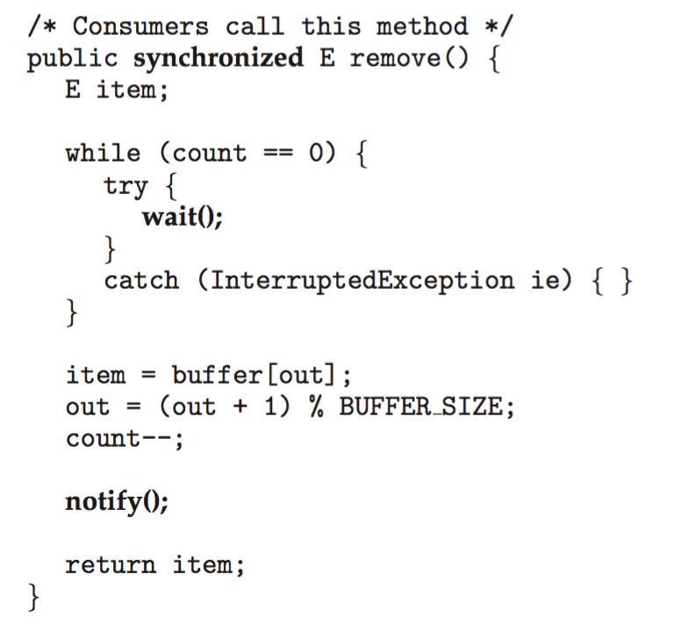
Bounded Buffer – Java Monitor
Move a producer or consumer from wait set to the entry set

Slide 7
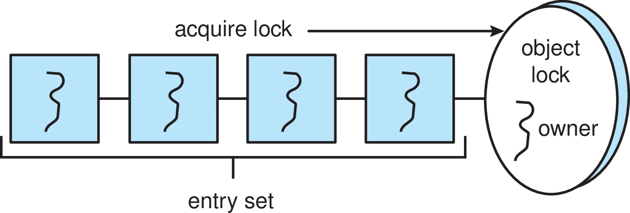
Java Synchronization
A thread that tries to acquire an unavailable lock is placed in the object’s entry set:

Slide 8
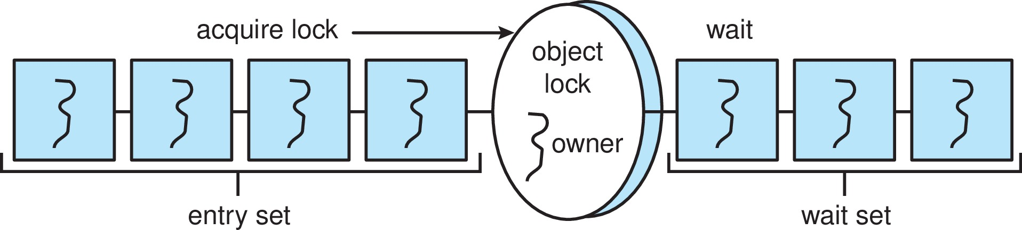
Java Synchronization
Similarly, each object also has a wait set.
When a thread calls wait():
It releases the lock for the object
The state of the thread is set to blocked
The thread is placed in the wait set for the object
wait
notify

Slide 9
Java Synchronization
A thread typically calls wait() when it is waiting for a condition to become true.
How does a thread get notified?
When a thread calls notify():
An arbitrary thread T is selected from the wait set
T is moved from the wait set to the entry set
Set the state of T from blocked to runnable.
T can now compete for the lock to check if the condition it was waiting for is now true.

Slide 10

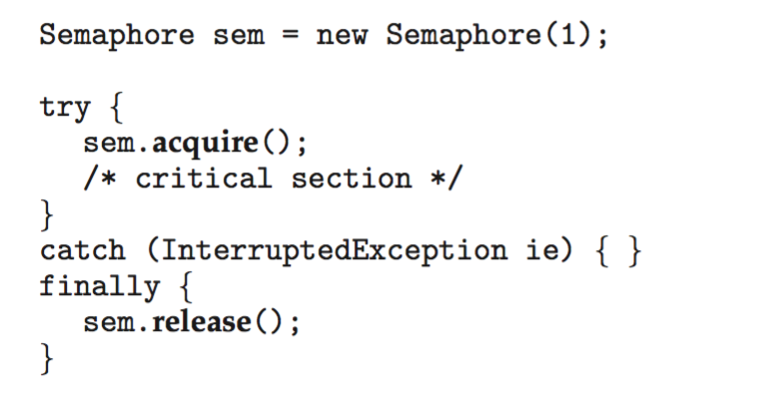
Java Semaphores
Constructor:
Usage:

Slide 11
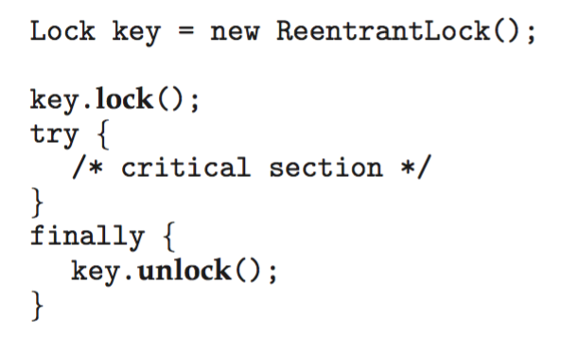
Java Reentrant Locks
Similar to mutex locks, allows threads to enter into the lock on a resource more than once.
Fairness: lock would go to the thread which has been waiting for the longest time.
The finally clause ensures the lock will be released in case an exception occurs in the try block.

Slide 12

Java Condition Variables
Condition variables are associated with an ReentrantLock.
Creating a condition variable using newCondition() method of ReentrantLock:
A thread waits by calling the await() method, and signals by calling the signal() method.

Slide 13
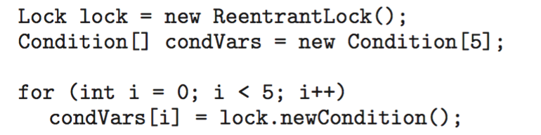
Java Condition Variables
Example
Five threads numbered 0 .. 4
Shared variable turn indicating which thread’s turn it is.
Thread calls doWork() when it wishes to do some work. (But it may only do work if it is their turn.
If not their turn, wait
If their turn, do some work for awhile …...
When completed, notify the thread whose turn is next.

Slide 14
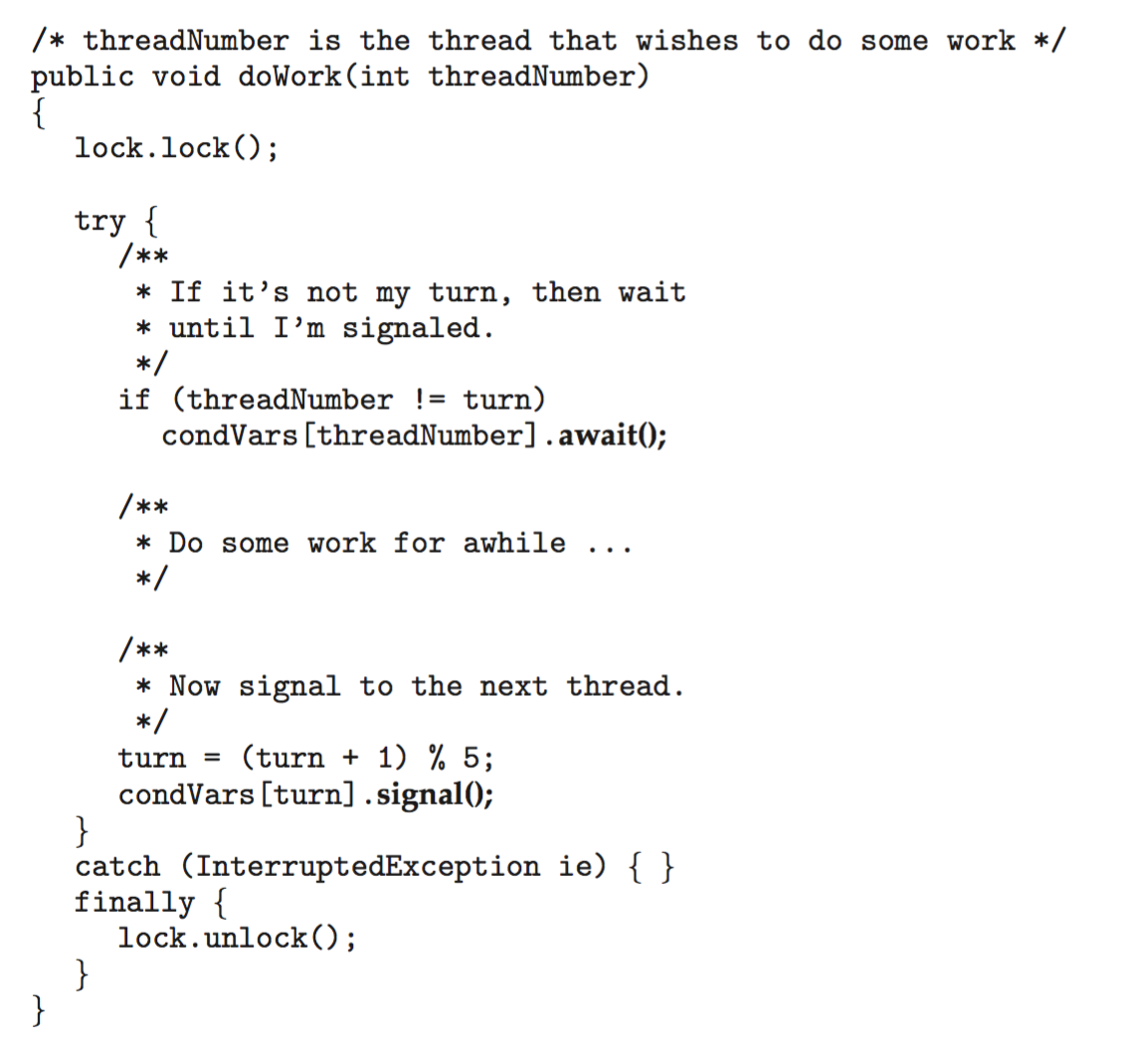
Java Condition Variables

Slide 15
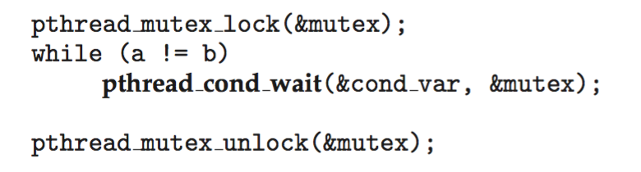
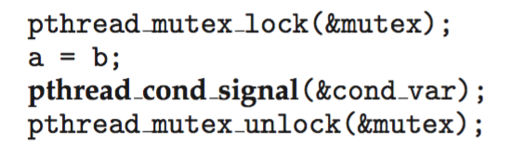
Question
How would use Java ReentrantLock and Condition variables to solve the problem we solved with POSIX Condition Variables.

Slide 16
Other Synchronization Approaches
Transactional Memory
OpenMP
Functional Programming Languages

Slide 17
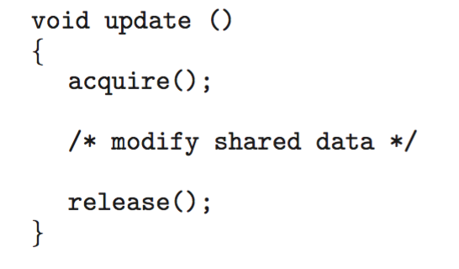
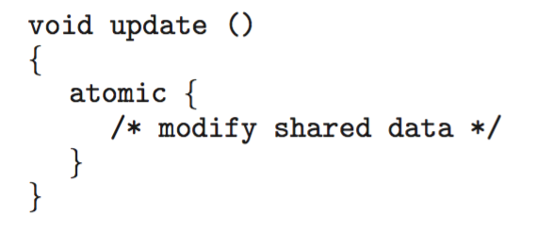
Transactional Memory
Consider a function update() that must be called atomically. One option is to use mutex locks:
A memory transaction is a sequence of read-write operations to memory that are performed atomically. A transaction can be completed by adding atomic{S} which ensure statements in S are executed atomically:

Slide 18
OpenMP
OpenMP is a set of compiler directives and API that support parallel programming.
void update(int value)
{
#pragma omp critical
{
count += value
}
}
The code contained within the #pragma omp critical directive is treated as a critical section and performed atomically.
Support parallel computing
#pragma omp parallel for
for (int i = 1; I < 100000; i++)
{
a[i] = b[i] + c[i];
}

Slide 19
Functional Programming Languages
Imperative (or procedure) languages (C, Java): values of variables and other data structures keep the program state
Functional programming languages offer a different paradigm than procedural languages in that they do not maintain state.
Variables are treated as immutable and cannot change state once they have been assigned a value
No concern for race conditions and deadlocks
There is increasing interest in functional languages such as Erlang and Scala for their approach in handling data races.

